Slide 1




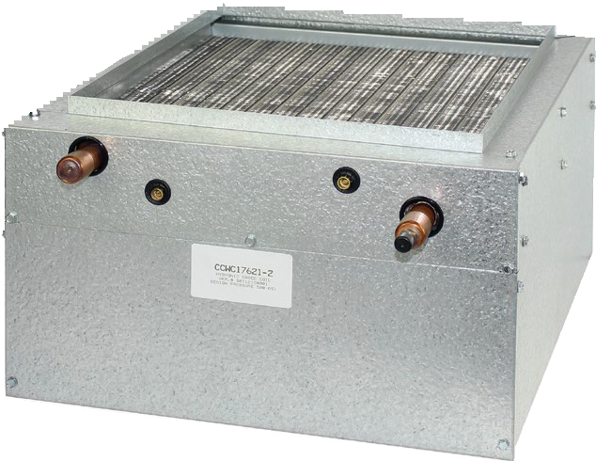
CCWC Series Cased Hot Water Coil
STANDARD SPECIFICATIONS
Hot Water Booster Coils
Vertical or Horizontal Installation
Factory leak tested at 500 psi. Sealed and pressurized with Nitrogen
Coils available for most OEM Multiple Position Air Handlers
20 Gauged Embossed Galvanized Cabinet
Fully Insulated Cabinet
Removable Split Front Panels
Mortex Products Inc.
501 Terminal Road
Fort Worth, Texas 76106
www.mortx.com

Slide 2


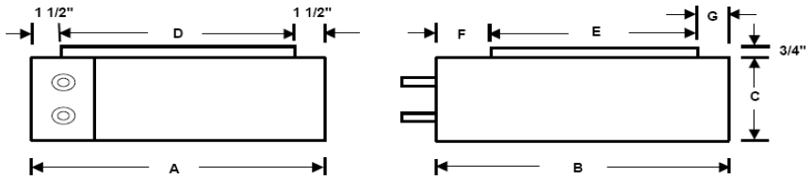
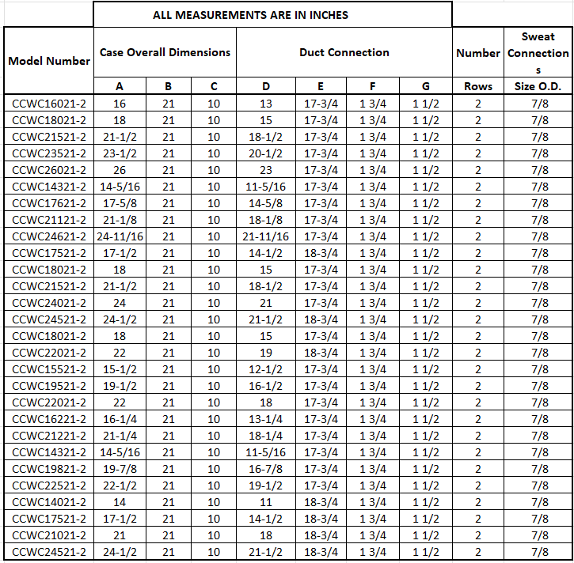
CCWC Series Cased Hot Water Coil
Features of CCWC Series Coil
Water Piping
Can be used for hot water
Air bleed vents are recommended and field installed
Insulate the supply and return hot water lines the entire length of run between the boiler or hot water heater and hydronic coil.
A nominal wall thickness of 1⁄2 inch flexible foam rubber closed-cell pipe insulation, suitable for 220°F is recommended.
Massachusetts requires an electronically controlled pump timer that activates the pump every 6 hours for 60 seconds and limits the distance between the water heater and the air handler to 50 feet max.
Residential Water Heater
A residential water heater is used for space heating.
The water heater should be the quick recovery type.
The coil and water heater must be located indoors, not subject to freezing temperatures.

Slide 3
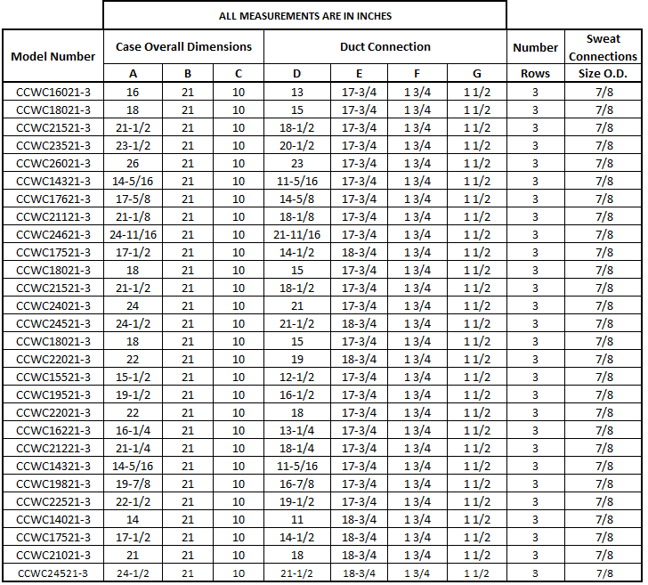




CCWC Series Cased Hot Water Coil
Printed in U.S.A © Copyright 2026 Summit 2PG SU10P0626
Mortex Products Inc. 501 Terminal Road Fort Worth, Texas 76106 800.444.6354 www.mortx.com

